Slide 1



uSpark
AI Medical Assistor
Sprint 3 Presentation
Team 1 – Rush Hour
CS691
April 2025

Slide 2

AGENDA
Team :
Roles and Responsibilities
Improvements
Project Overview:
Problem Statement
Project Description
Working Agreement
Personas
Product Design
MVP Design
Technology:
Technologies
Algorithms
Diagrams
Product Backlog
Sprint Backlog:
Backlog
Test Cases
Completed
Not Completed
Sprint 3 Metrics:
Velocity
Burndown Chart
Committed Ratio
Sprint 3 Retrospective
Product Demo

Slide 3
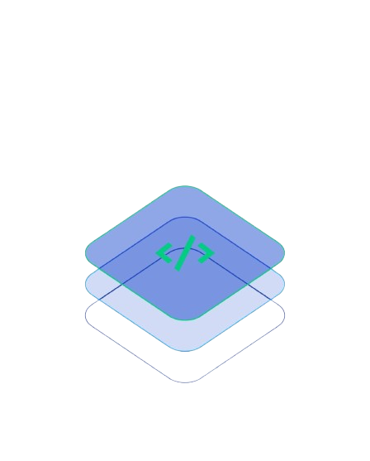
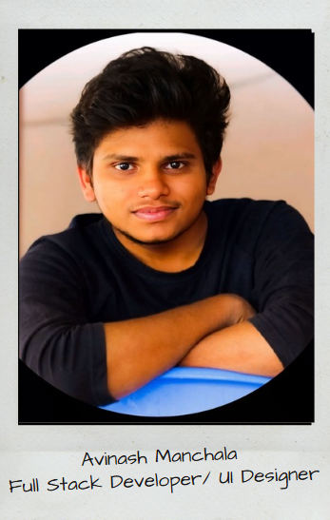
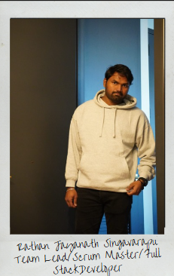
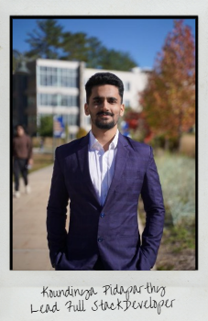
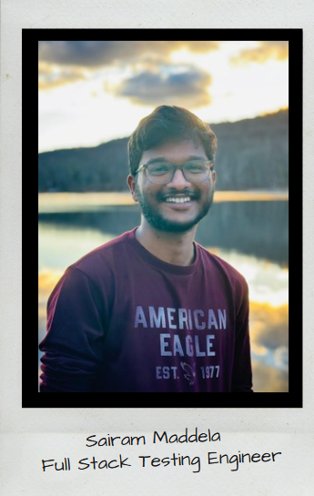
FULL STACK TEAM

Slide 4

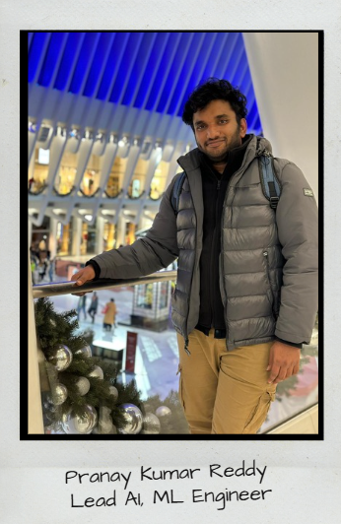
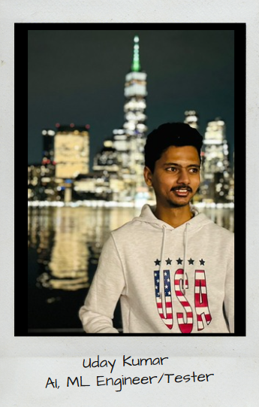
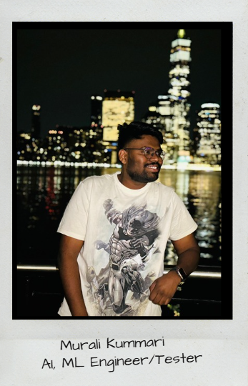
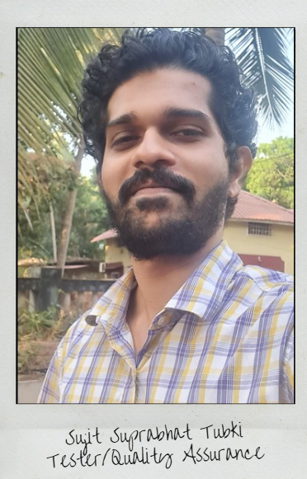
ML AI TEAM

Slide 5
Improvements from professor
Improve product backlog
Modified the API screenshots
Proper explanation of sprint planning

Slide 6
PROBLEM STATEMENT
Continuous Medical Assistance is one of a non-negotiable requirement these days and it can't be ignored. It is tedious to manage and store data related to a diagnosis of a patient for hospitals and for the patient as well. A simplified way of managing health care is needed, which can be achieved through AI chatbot and smart data storage system and like wise professionals in the medical sector can use a trained ML based algorithm service to reduce manual effort in the patient diagnosis.
This creates a hassle-free environment for both patient and doctors.

Slide 7
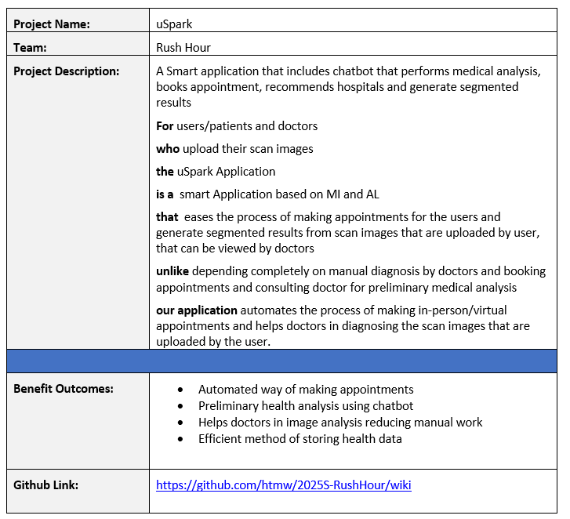
PROJECT DESCRIPTION
1

Slide 8
PROJECT DESCRIPTION
A robust approach to ease the process of health care and management with just one click!
➔“uSpark” is an Intelligent full stack application incorporated with machine learning that is an ultimate go-to point for the users/patients for all their healthcare related issues. uSpark allows users to schedule appointments in a hassle-free manner.
➔ These appointments can be virtual or in-person using “Uheal” a smart chatbot in the application that diagnoses the patient condition with the help of few questions. uSpark stores all the assessment details of the patient for further usage.
➔ Doctors can use uSpark as their personal virtual assistant that helps them in their work for managing appointments and patients records. It provides doctors with “Useg” a well-trained ML algorithm that precisely processes bio-medical images that produces an output

Slide 9
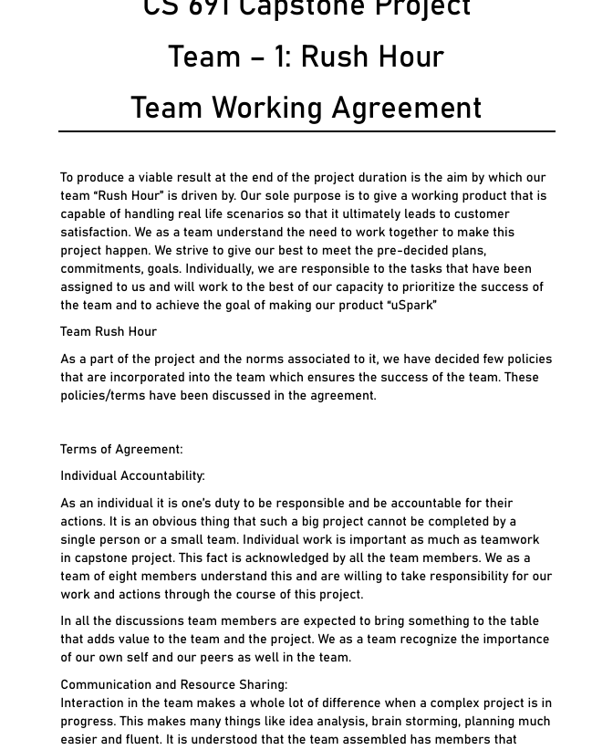
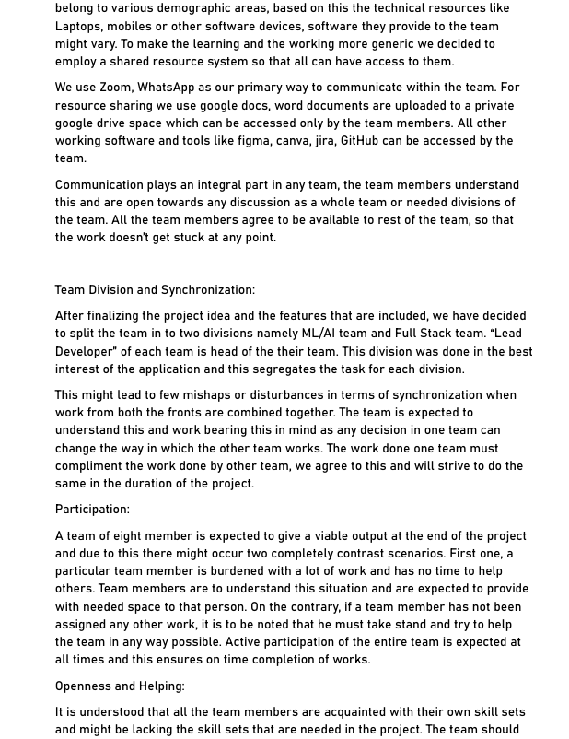
Team Working Agreement
Link:
Team working agreement
1

Slide 10
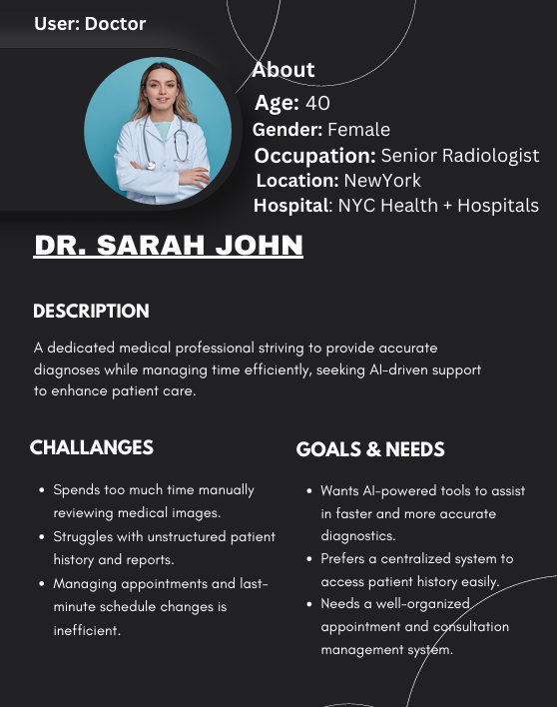
Persona 1
1

Slide 11
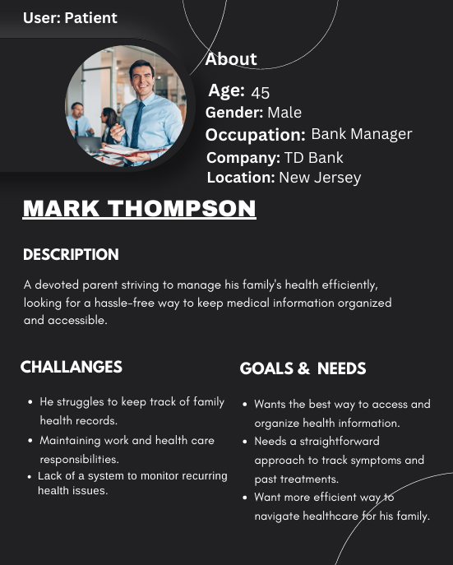
Persona 2
1

Slide 12
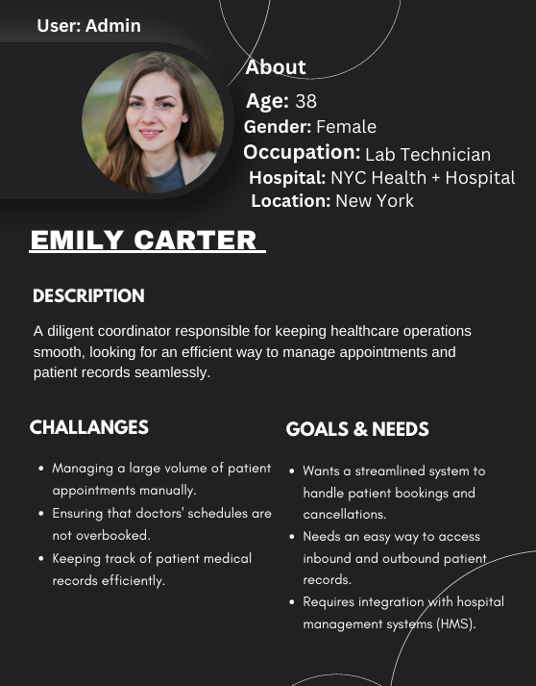
Persona 3
1

Slide 13
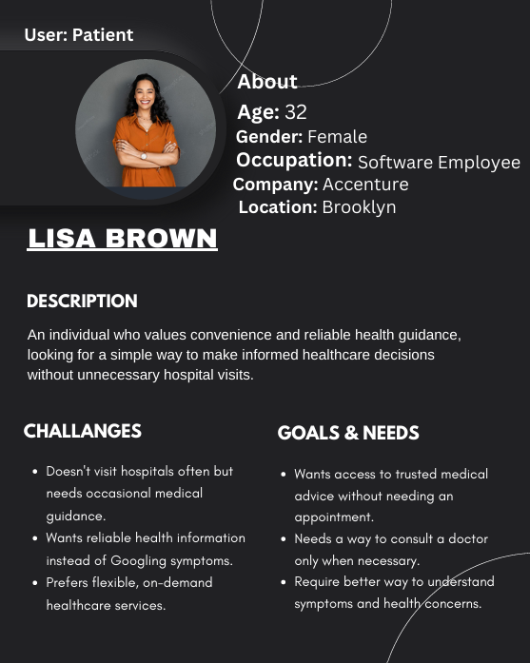
Persona 4
1

Slide 14

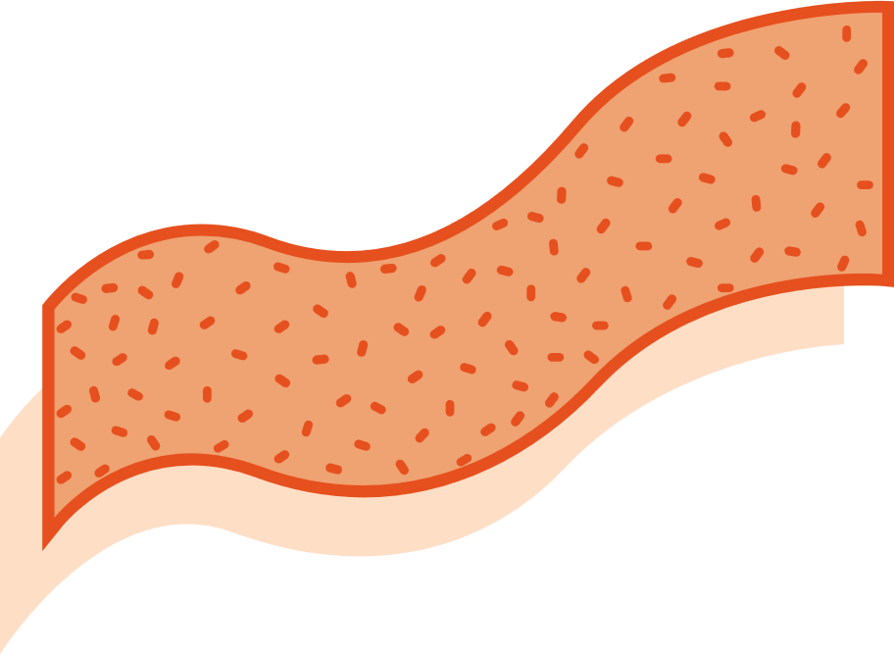




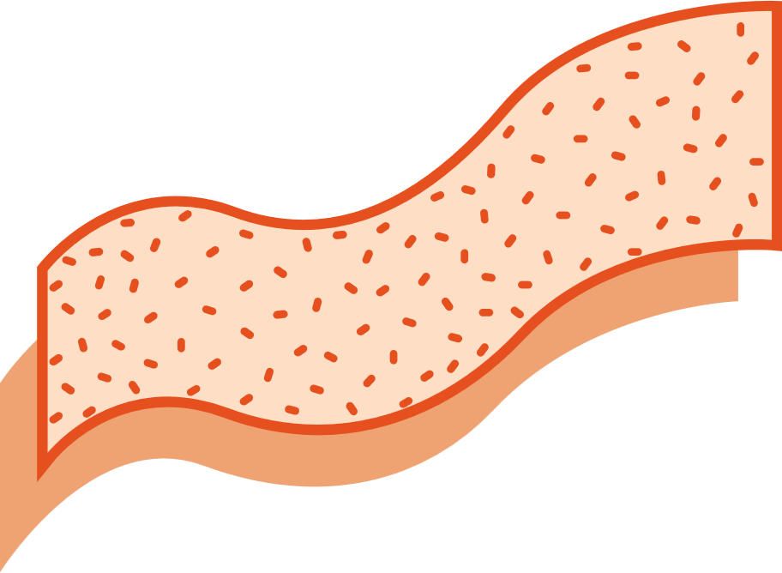



uSpark Application
MVP
HOSPITAL RECOMMENDATIONS
BOOK APPOINTMENTS!!
Users can now see recommendations of hospitals that might be suitable for their issue. These recommendations on their assessment done via a series of questions asked by our chatbot “Uheal”
Distance from Hospital, working hours can be seen.
uSpark allows users to make appointments which can be in-person or virtual based on their availability and doctor’s availability , in contrast to the traditional way of making appointments
ONE CARD
uHeal stores the details of the health issue of the patient which is obtained from the conducted assessment, all the assessment details are saved on ONE CARD along with the date of assessment. One card involves patient’s assessment details, insurance details, personal details and a QR code that is used to share the ONE CARD, this completely eliminates the need for physical documents to store information.
CHATBOT – Uheal
uHeal conducts an assessment for the patients with the help of a series of questions, and also gives a few preventive measures and It also makes appointments for the user by giving recommendations about hospitals, in contrast to the traditional method of searching hospitals
Useg
Useg is an ML algorithm that is used by doctors as a part of their diagnosis.
This makes their work easier and helps them to narrow down the issue in a much quicker way

Slide 15
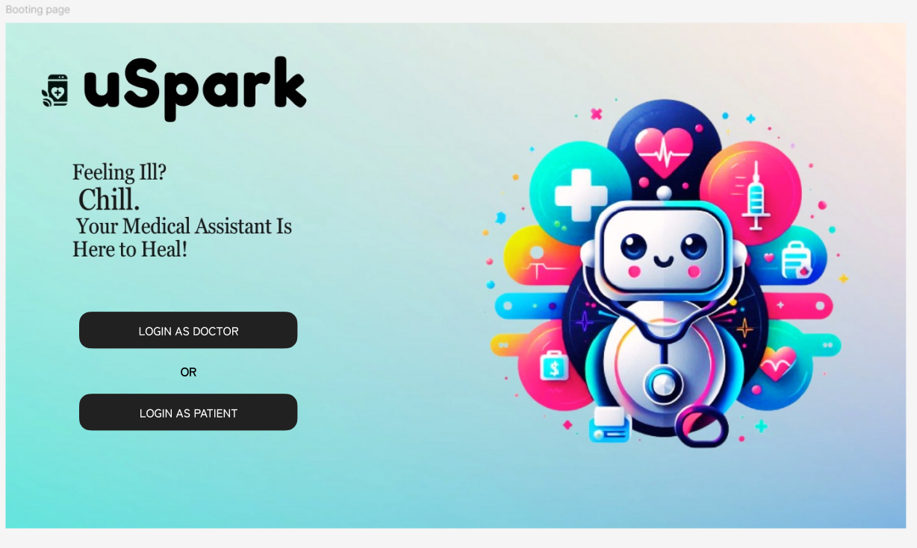
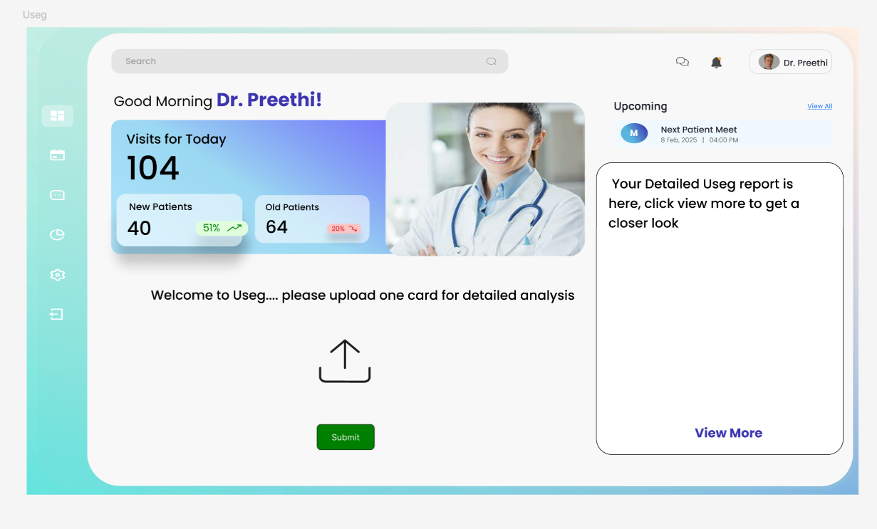
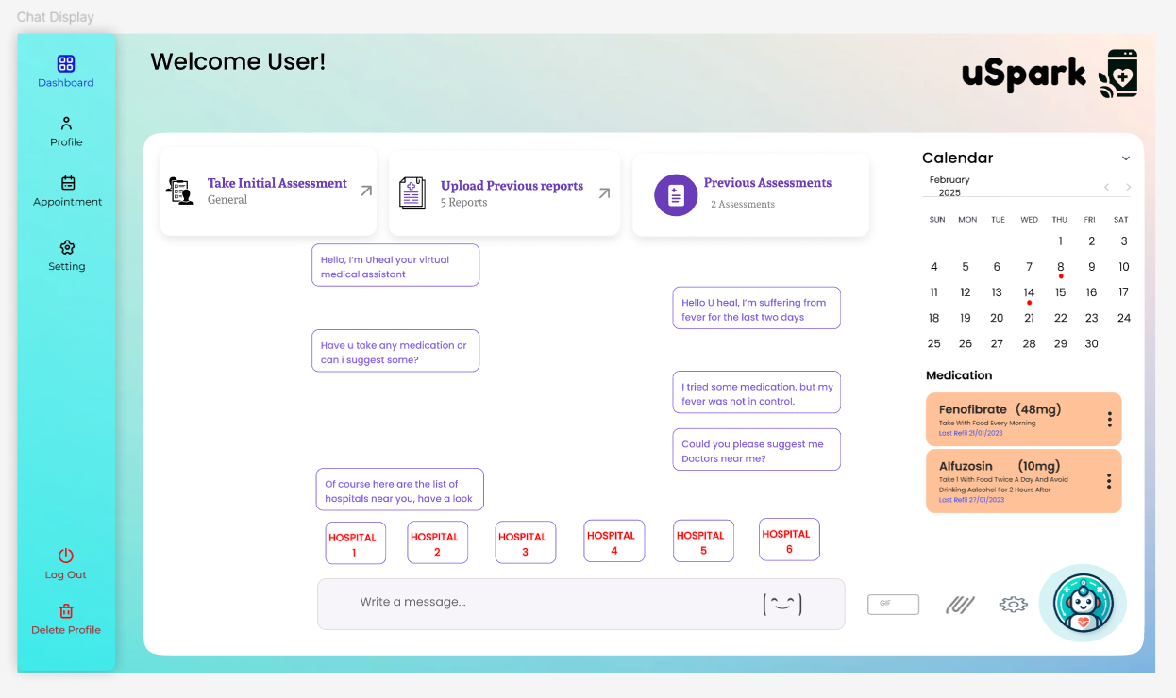
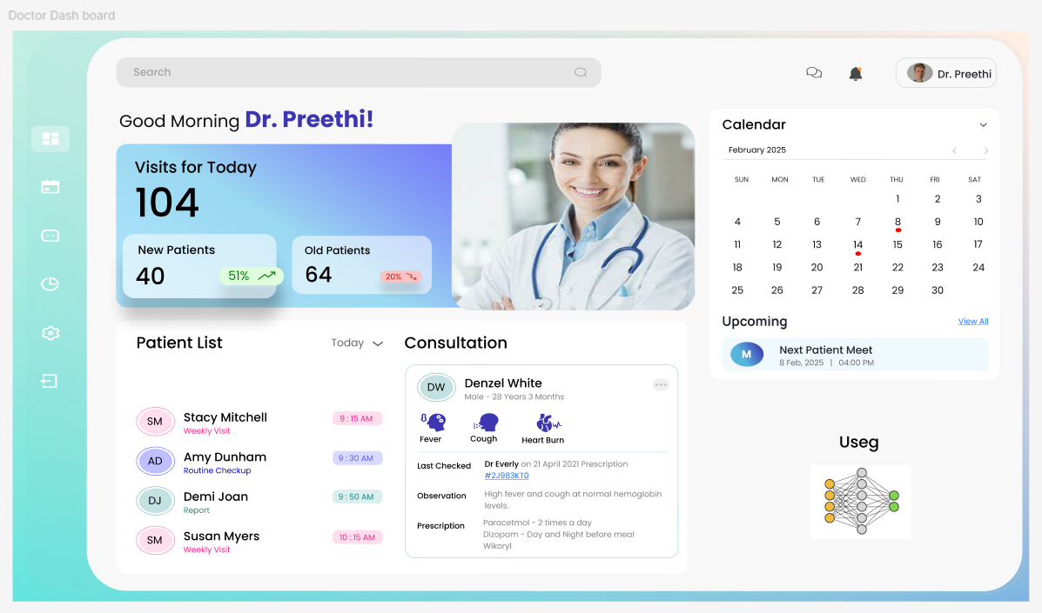
Product Design

Slide 16
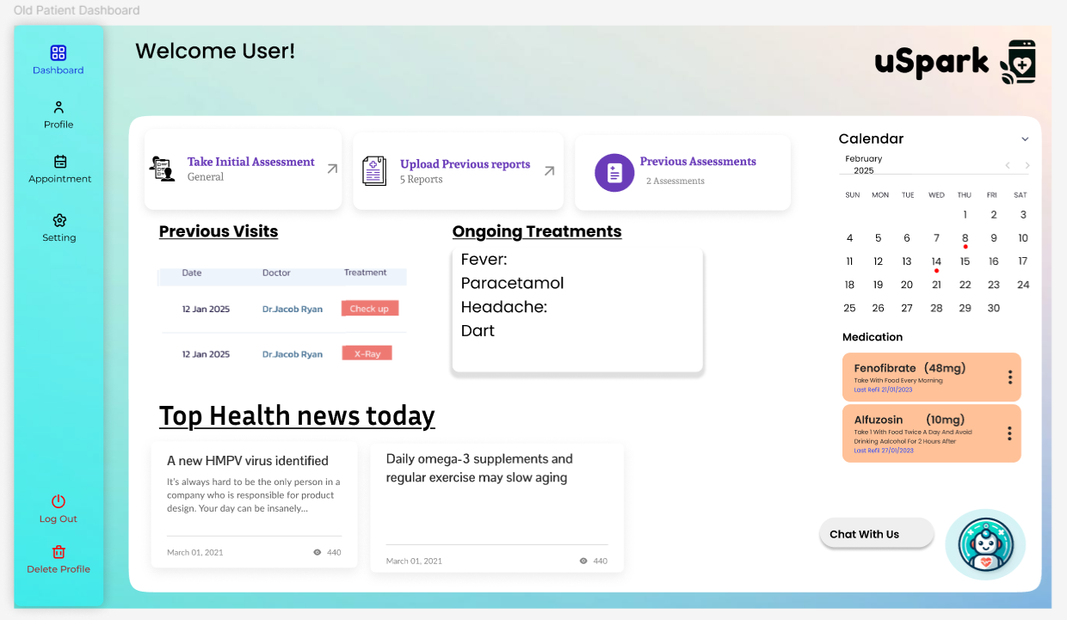
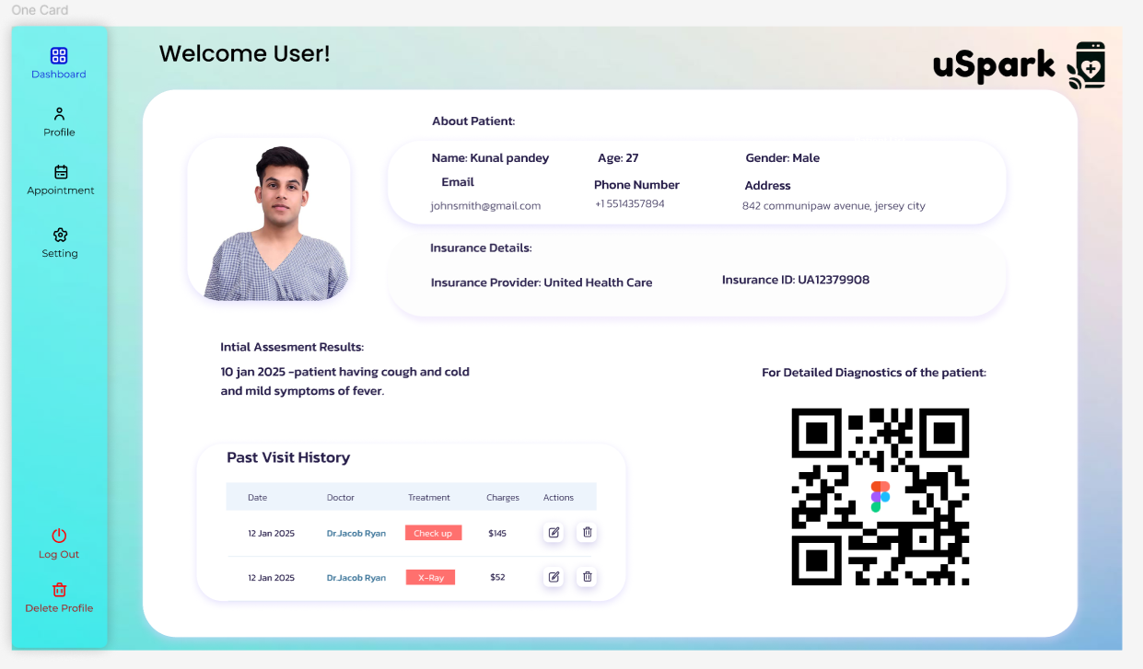
MVP Design

Slide 17






Technologies and Tools
Full Stack /ML AI Programming Languages
Node JS
React
Python
Node.js – JavaScript runtime used to build the backend services (server-side logic).
React.js – JavaScript library for building dynamic, responsive frontends.
Redux – Helps manage application-wide state in React smoothly.
Axios – Used for making API requests between frontend and backend.
Material UI – React-based UI toolkit for building visually appealing user interfaces.
Python – Main language for AI/ML development and backend scripting.
Redux
Axios
Material UI

Slide 18







Technologies and Tools
Libraries, Algorithms and Frameworks, Database
Mongo DB
Amazon S3
MongoDB – NoSQL database for storing flexible healthcare records like assessments and profiles.
Amazon S3 (AWS) – Cloud storage used for securely storing medical files, images, and reports.
Faiss Vector DB – Specialized database used in AI for similarity search and fast retrieval (helpful in hospital recommendations).
TensorFlow – ML framework used to build and train models like image processors.
PyTorch – Another flexible ML library used for model experimentation.
Flask – A Lightweight web framework to serve ML models via APIs.
Faiss Vector Database
MERN Stack
Pytorch
TensorFlow
Flask

Slide 19


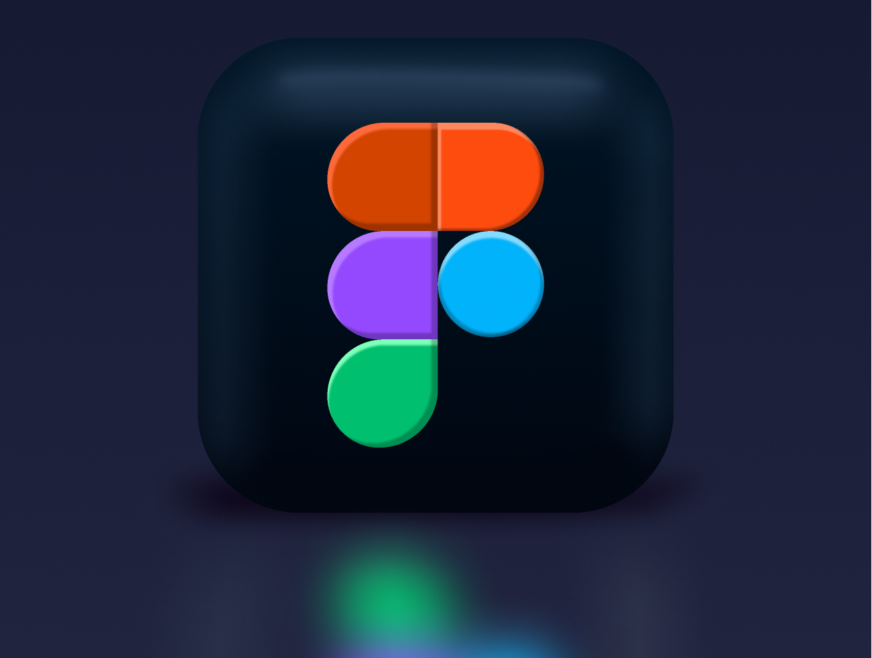



Technologies and Tools
Tools
Jira
Docker
Docker – Used to containerize applications for consistent deployment across environments.
VS Code – Code editor for development with built-in Git and extension support.
GitHub – Version control and collaboration platform for code.
Postman – Tool for testing and verifying API functionality during development.
Figma – Tool for designing UI/UX prototypes collaboratively.
Jira – Agile tool for managing sprints, tasks, and team workflow.
Figma
VS code
Postman
GitHub

Slide 20
Algorithms And Models:
RAG (Retrieval-Augmented Generation): Combines document retrieval with text generation to provide accurate, knowledge-based responses—used in our chatbot to give more informed medical answers.
DenseNet (Densely Connected Convolutional Network): A deep learning model that strengthens feature reuse and reduces computation, used for analyzing biomedical images efficiently.
ResNet (Residual Neural Network): A powerful model designed to solve vanishing gradient issues helps improve the accuracy of medical image diagnosis.
DialoGPT: A conversational AI model trained for dialogue generation—used to make our chatbot (Uheal) interactive and human-like in communication.

Slide 21
Diagrams

Slide 22
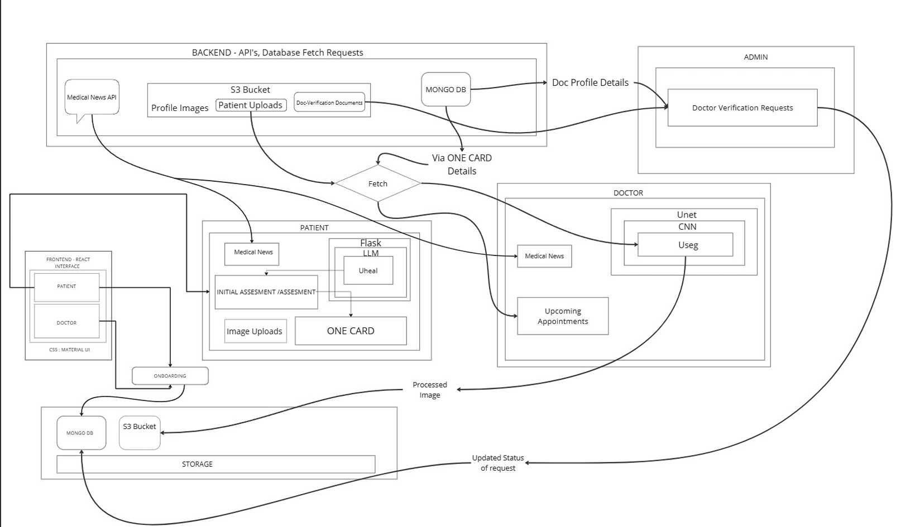
Architecture Diagram

Slide 23
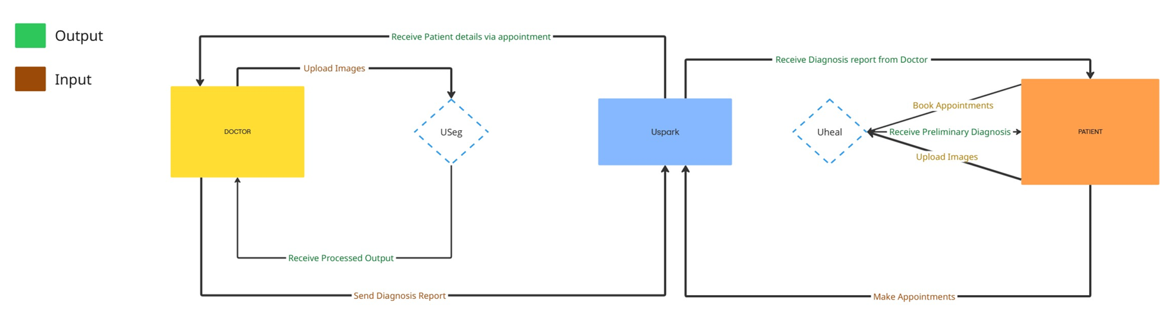
Context Diagram

Slide 24
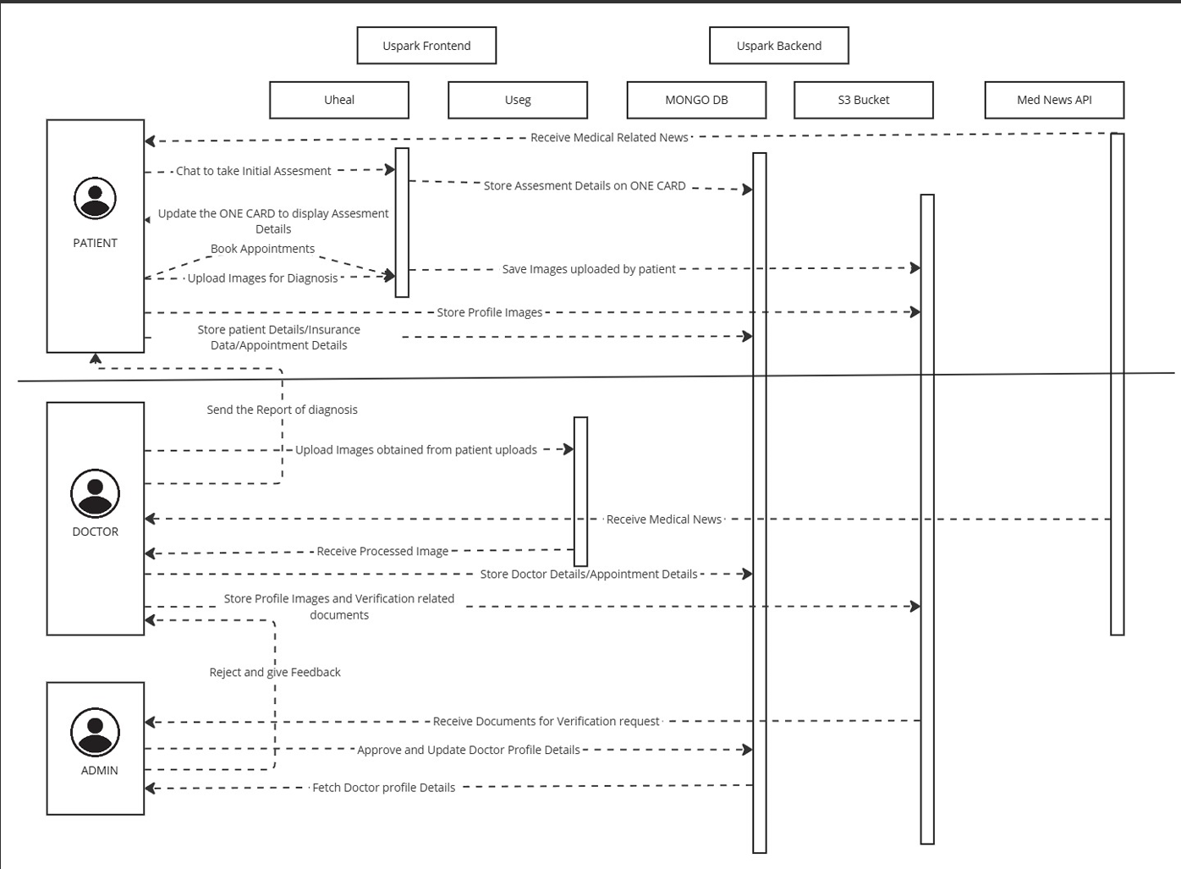
Sequence Diagram

Slide 25
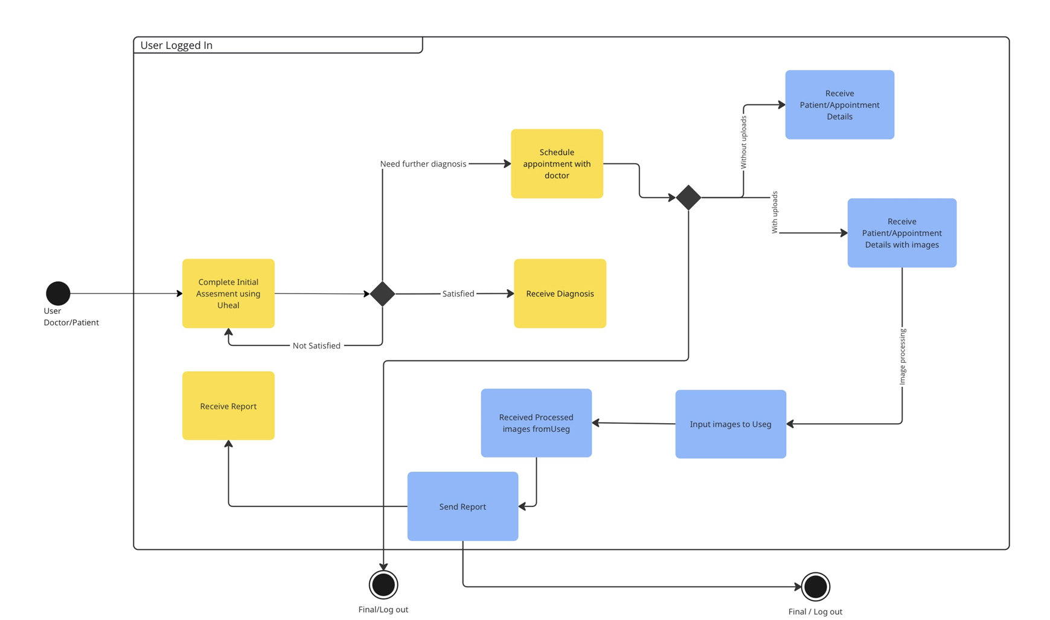
State Diagram

Slide 26
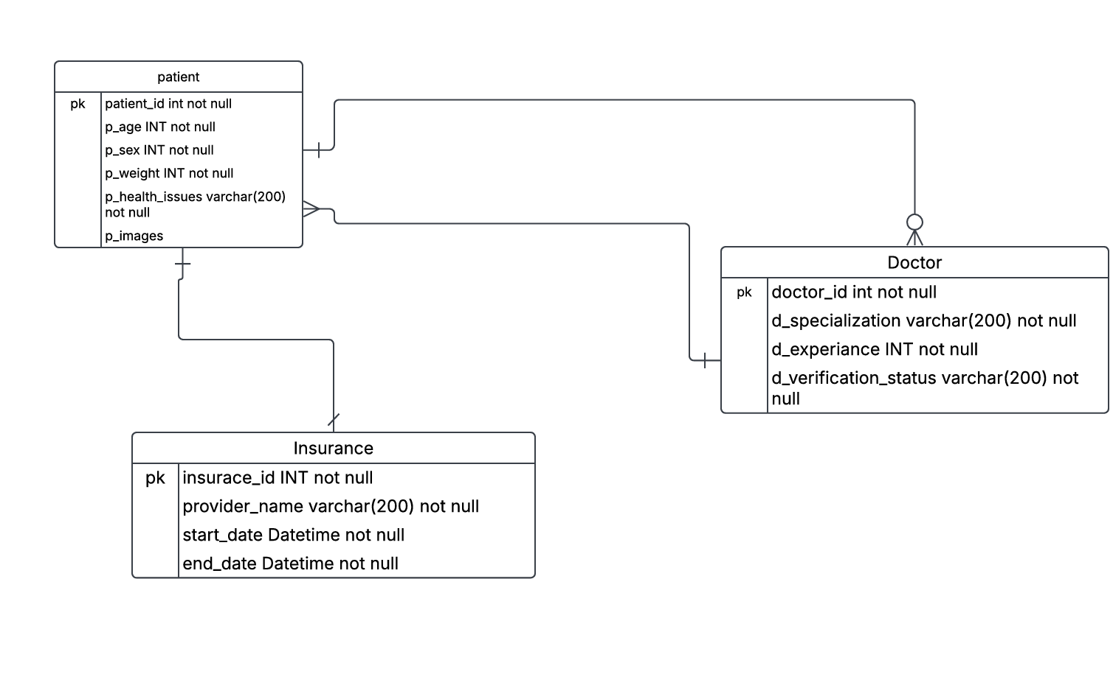
Class Diagram

Slide 27
Sprint 2 Recap:
In Sprint 2, we focused on enhancing the functionalities of our application by improving patient experience, doctor assistance, and backend structures. The following features were successfully implemented:
Hospital Recommendations: Users can view recommended hospitals based on their health assessments and proximity.
ONE CARD Implementation: Patients’ personal details, insurance information, and health assessments are stored securely with a shareable QR code.
Chatbot Enhancements: Uheal chatbot conducts assessments, provides preventive measures, and assists in appointment scheduling.
Useg ML Model Integration: Doctors can utilize AI-powered biomedical image analysis to assist in diagnosis.
36 Story Points
Completed 29 Story Points

Slide 28
Product Backlog
S.NO | USER STORIES | ACCEPTANCE CRITERIA | STORY POINTS
US_23 | As a doctor, I want to get heat maps and segmented outputs for easier diagnosis. | So that, Doctor receives a list of potential diagnoses based on patient data. | 8
US_27 | As an admin, my dashboard needs access by me only not by others for security purposes. | So that, Admin dashboard is secured with role-based access control and audit logs. | 5
US_12 | As a patient, I want to see ratings and reviews for doctors before booking an appointment | So that, the patient can view average ratings and user reviews for each listed doctor. | 5
US_26 | As an admin, I want to manage and verify doctors’ credentials before they are approved. | So that, Admin can view, verify, and approve doctor credentials via dashboard. | 5
US_24 | As a doctor, I want to get potential diagnoses based on biomedical images. | So that, Doctor receives a list of potential diagnoses based on patient data. | 5
US_22 | As a doctor, I want to upload medical images (X-rays, MRIs, CT scans) for AI processing. | So that, Doctor can upload and review medical images linked to a patient. | 5
US_18 | As a doctor, I want to register and submit my credentials for verification. | So that, Doctor can submit credentials and profile information for verification. | 5
US_17 | As a patient, I want to link my health insurance to cover consultation charges. | So that, Patient can link valid insurance information to be used during billing. | 5

Slide 29
Product Backlog
S.NO | USER STORIES | ACCEPTANCE CRITERIA | STORY POINTS
US_15 | As a patient, I want to join a video call for virtual consultations | So that, Patient can join secure video calls at scheduled consultation time. | 5
US_21 | As a doctor, I want to manage my patients' health records and notes. | So that, Doctor can write or update notes in their profile, and the system will save the information securely. | 3
US_13 | As a patient, I want to receive a preliminary diagnosis from application based on my symptoms. | So that, Chatbot provides preliminary diagnosis based on patient's symptom inputs. | 3
US_1 | As a patient, I want to sign up using email, phone, or social media so that I can access the application. | So that, Patient can sign up using email, or social media with validation and secure transmission. | 3
US_11 | As a patient, I want to search for doctors based on specialty, availability, and location. | So that, Patient can search for doctors using filters like specialization and rating. | 3
US_8 | As a patient, I want to choose between virtual or in-person appointments. | So that, Patient can choose virtual or in-person consultation during appointment booking. | 3
US_6 | As a patient, I want to share my medical history with doctors for better diagnosis. | So that, Patient can share selected medical records with doctors before or during appointments. | 3
US_5 | As a patient, I want to store my past medical assessments and reports for future reference. | So that, Patient can upload medical files and view/download them later securely. | 3

Slide 30
Product Backlog
S.NO | USER STORIES | ACCEPTANCE CRITERIA | STORY POINTS
US_4 | As a patient, I want to view my past appointments and prescriptions in my profile. | So that, Patient can view historical appointments and prescriptions from profile. | 3
US_3 | As a patient, I want to create and update my profile with personal details, and insurance information. | So that, Patient can create and update personal profile with validated fields. | 3
US_14 | As a patient, I want suggestions whether I need an in-person visit, virtual consultation, or self-care. | So that, AI engine suggests whether doctor consultation is needed based on symptoms. | 3
US_2 | As a patient, I want to reset my password in case I forget it. | So that, Patient can reset password via email link after identity verification. | 2
US_9 | As a patient, I want to receive appointment confirmation via email or SMS. | So that, Appointment confirmation via email/sms via uheal. | 2
US_19 | As a doctor, I want to login to my profile, and view my details | So that, Doctor can log in, update profile, and manage security settings. | 2
US_20 | As a doctor, I want to see a list of my upcoming and past appointments. | So that, Doctor sees dashboard listing upcoming appointments by date/time. | 2
US_7 | As a patient, I want to schedule an appointment with a doctor based on available time slots. | So that, Patient can select doctor, date, and time to schedule an appointment with confirmation. | 2

Slide 31
Product Backlog
S.NO | USER STORIES | ACCEPTANCE CRITERIA | STORY POINTS
US_10 | As a patient, I want to reschedule or cancel an appointment. | So that, Patient can reschedule or cancel an appointment with confirmation and reason. | 1
US_16 | As a patient, I want recommend doctors based on my condition. | So that, Patient can enter their symptoms, and the system will use AI to suggest the best doctor. | 1
US_25 | As a doctor, I want to receive notifications when a patient books or cancels an appointment. | So that, Doctor is notified of upcoming, missed, or rescheduled appointments. | 1

Slide 32
SPRINT 1 SUMMARY
S.NO | USER STORIES | ACCEPTANCE CRITERIA | FEATURE | STORY POINTS
US_01 | As a patient, I want to sign up using email, phone, or social media so that I can access the application. | So that, Given a patient accesses the signup page, When they enter valid credentials (email, phone, or social media), Then they should successfully create an account and log in. | Patient sign-up via email, phone, or social media | 3
US_17 | As a patient, I want to link my health insurance to cover consultation charges. | So that, Given a patient is logged in, when they update personal, medical, or insurance details, then the changes should be saved. | Patient profile management | 5
US_18 | As a doctor, I want to register and submit my credentials for verification. | So that, Given a doctor registers, when they submit credentials, then the system should send it for admin approval. | Doctor registration and Onboarding | 5
US_22 | As a doctor, I want to get heat maps and segmented outputs for easier diagnosis. | So that, Given an image is processed, when AI detects anomalies, then the doctor should receive a heatmap/segmentation output. | AI-based heat maps & segmented output via Useg. | 8
US_25 | As an admin, I want to manage and verify doctors’ credentials before they are approved. | So that, Given a doctor submits credentials, when the admin reviews them, then they should be able to approve or reject the request. | Manage doctor verification & approval via Admin dashboard. | 5
US_26 | As an admin, I want to manage and verify doctors’ credentials before they are approved. | So that, Given a doctor logs in and submits documents for verification, they must be verified by admin | Admin Dashboard | 5

Slide 33
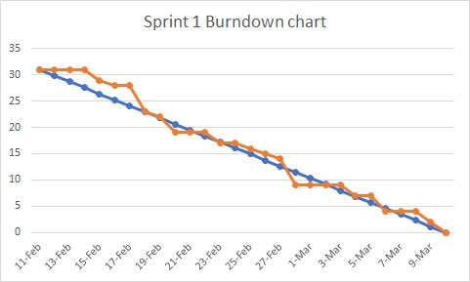
SPRINT 1 BURNDOWN CHART

Slide 34
SPRINT 2 SUMMARY
S.NO | USER STORIES | ACCEPTANCE CRITERIA | FEATURE | STORY POINTS
US_02 | As a patient, I want to reset my password in case I forget it. | So that, Patient can reset password via email link after identity verification. | Password reset functionality | 2
US_03 | As a patient, I want to create and update my profile with personal details, medical history, and insurance information. | So that, Patient can create and update personal profile with validated fields. | Patient profile management | 3
US_05 | As a patient, I want to store my past medical assessments and reports for future reference. | So that, Patient can upload medical files and view/download them later securely. | Share medical history with doctors | 3
US_06 | As a patient, I want to share my medical history with doctors for a better diagnosis. | So that, Patient can share selected medical records with doctors before or during appointments. | Appointment scheduling via Uheal. | 3
US_07 | As a patient, I want to schedule an appointment with a doctor based on available time slots. | So that, Patient can select doctor, date, and time to schedule an appointment with confirmation. | Appointment scheduling via Uheal. | 2
US_08 | As a patient, I want to choose between virtual or in-person appointments. | So that, Patient can choose virtual or in-person consultation during appointment booking. | Choose virtual or in-person consultation via Uheal. | 3

Slide 35
SPRINT 2 SUMMARY
S.NO | USER STORIES | ACCEPTANCE CRITERIA | FEATURE | STORY POINTS
US_09 | As a patient, I want to receive appointment confirmation via email or SMS. | So that, Appointment confirmation via email/sms via uheal. | Appointment confirmation via email/SMS via Uheal. | 2
US_10 | As a patient, I want to reschedule or cancel an appointment. | So that, Patient can reschedule or cancel an appointment with confirmation and reason. | Reschedule or cancel appointments via Uheal. | 1
US_13 | As a patient, I want to receive a preliminary diagnosis from application based on my symptoms. | So that, System provides preliminary diagnosis based on patient's symptom inputs. | AI-based preliminary diagnosis via Uheal. | 3
US_16 | As a patient, I want recommend doctors based on my condition. | So that, Patient can enter their symptoms, and the system will use AI to suggest the best doctor. | AI doctor recommendations based on condition. | 1
US_19 | As a doctor, I want to manage my profile, including my specialty, availability, and appointment preferences. | So that, Doctor can log in, update profile, and manage security settings. | Doctor profile management | 2
US_20 | As a doctor, I want to see a list of my upcoming and past appointments. | So that, Doctor sees dashboard listing upcoming appointments by date/time. | Appointment Scheduling | 2

Slide 36
SPRINT 2 SUMMARY
S.NO | USER STORIES | ACCEPTANCE CRITERIA | FEATURE | STORY POINTS
US_21 | As a doctor, I want to manage my patients' health records and notes. | So that, Doctor can write or update notes in their profile, and the system will save the information securely. | Manage patient health records and notes can be done with one card | 3
US_22 | As a doctor, I want to upload medical images (X-rays, MRIs, CT scans) for AI processing. | So that, Doctor can upload and review medical images linked to a patient. | Upload medical images (X-rays, MRIs, CT scans) for AI processing via Useg. | 5
US_25 | As a doctor, I want to receive notifications when a patient books or cancels an appointment. | So that, Doctor is notified of upcoming, missed, or rescheduled appointments. | Receive notifications for appointments | 1

Slide 37
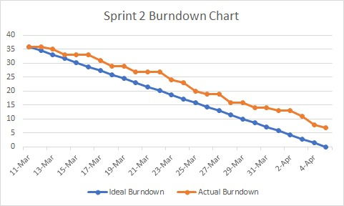
SPRINT 2 BURNDOWN CHART

Slide 38
SPRINT 3 STORIES
S.NO | USER STORIES | ACCEPTANCE CRITERIA | FEATURE | STORY POINTS
US_4 | As a patient, I want to view my past appointments and prescriptions in my profile. | So that, Patient can view historical appointments and prescriptions from profile. | View past appointments & prescriptions | 3
US_11 | As a patient, I want to search for doctors based on specialty, availability, and location. | So that, Patient can search for doctors using filters like specialization and rating. | Search doctors based on specialty, availability, and location via Uheal. | 3
US_12 | As a patient, I want to see ratings and reviews for doctors before booking an appointment | So that, Patient can view average ratings and user reviews for each listed doctor. | View doctor ratings and reviews via Uheal. | 5
US_14 | As a patient, I want suggestions whether I need an in-person visit, virtual consultation, or self-care. | So that, AI engine suggests whether doctor consultation is needed based on symptoms. | AI-based consultation suggestions via Uheal. | 3
US_15 | As a patient, I want to join a video call for virtual consultations | So that, Patient can join secure video calls at scheduled consultation time. | Video call for virtual consultations via Uheal. | 5
US_24 | As a doctor, I want to get potential diagnoses based on biomedical images. | So that, Doctor receives a list of potential diagnoses based on patient data. | Receive notifications for appointments | 5

Slide 39
SPRINT 3 STORIES
S.NO | USER STORIES | ACCEPTANCE CRITERIA | FEATURE | STORY POINTS
US_5 | As a patient, I want to store my past medical assessments and reports for future reference. | So that, Patient can upload medical files and view/download them later securely. | Upload & store medical assessments and reports | 2
US_8 | As a patient, I want to choose between virtual or in-person appointments. | So that, Patient can choose virtual or in-person consultation during appointment booking. | Choose virtual or in-person consultation via Uheal. | 2
US_13 | As a patient, I want to receive a preliminary diagnosis from application based on my symptoms. | So that, System provides preliminary diagnosis based on patient's symptom inputs. | AI-based preliminary diagnosis via Uheal. | 1
US_22 | As a doctor, I want to upload medical images (X-rays, MRIs, CT scans) for AI processing. | So that, Doctor can upload and review medical images linked to a patient. | Upload medical images (X-rays, MRIs, CT scans) for AI processing via Useg. | 1

Slide 40
SPRINT 3 TEST CASES
US_ID | TC_ID | Test Case | Steps | Execution Status | Result
US_04 | TC_36 | View Past Appointments and Prescriptions in Profile | 1. Launch the application 2. Login as a patient using valid credentials 3. Navigate to the “Appointments“, section 4. Verify that all previous appointment details 5. Verify that prescription history | All prescriptions related to past appointments are visible under the prescriptions section. | Pass
US_11 | TC_37 | Search Doctors Based on Specialty, Availability | 1. Login as a patient 2. Navigate to the "Find Doctors" page 3. Enter or select a specialty, Availability, and Location filter 4. Click on "Search" button | List of doctors matching selected specialty, availability, and location criteria is displayed. | Pass
US_12 | TC_38 | View Doctor Ratings and Reviews Before Booking | 1. Login 2. Navigate to "Find Doctors" 3. Search for a doctor 4. Check ratings and reviews displayed for each doctor | Ratings and reviews should be correctly visible under each doctor’s profile before booking. | Fail
US_14, US_15 | TC_39 | Suggest In-Person, Virtual on Symptoms | 1. Login 2. While Booking an appointment 3. will Provide a select option to select 4. Select which mode you want | System suggests either in-person visit, virtual consultation, or self-care based on symptom severity | Pass

Slide 41
SPRINT 3 TEST CASES
US_ID | TC_ID | Test Case | Steps | Execution Status | Result
US_24 | TC_41 | Get Potential Diagnoses from Biomedical Images | 1. Login as a doctor 2. Navigate to "Image Diagnosis" section 3. Upload a biomedical image (e.g., X-ray, MRI) 4. Click "Analyze | System processes the image and displays a list of potential diagnoses based on analysis. | Pass
US_5 | TC_42 | Upload and Store Past Medical Assessments and Reports | 1. Login as patient 2. Navigate to "Medical Records" 3. Upload assessment files or reports 4. Save the uploaded files | Files are securely uploaded, stored, and available for future view/download. | Fail
US_08 | TC_43 | Choose Between Virtual or In-Person Appointment | 1. Login as a patient 2. Navigate to "Book Appointment" 3. Select doctor and preferred date/time 4. Choose either "Virtual" or "In-Person" option 5. Confirm booking | Appointment is successfully booked with selected consultation type (Virtual/In-Person) shown in confirmation. | Pass

Slide 42
SPRINT 3 TEST CASES
US_ID | TC_ID | Test Case | Steps | Execution Status | Result
US_13 | TC_44 | Get Preliminary Diagnosis Based on Symptoms | 1. Login as a patient 2. Navigate to "Symptom Checker" 3. Enter symptoms in the form 4. Submit assessment | System displays a preliminary diagnosis based on the entered symptoms. | Pass
US_22 | TC_45 | Upload Medical Images for AI Processing | 1. Login as doctor 2. Navigate to "Upload Images" 3. Select patient 4. Upload X-ray/MRI/CT scan file 5. Submit for processing | Medical images are securely uploaded, linked to the patient, and ready for AI analysis. | Pass

Slide 43
SPRINT 3 STORIES COMPLETED
S.NO | USER STORIES | ACCEPTANCE CRITERIA | FEATURE | STORY POINTS
US_4 | As a patient, I want to view my past appointments and prescriptions in my profile. | So that, Patient can view historical appointments and prescriptions from profile. | View past appointments & prescriptions | 3
US_11 | As a patient, I want to search for doctors based on specialty, availability, and location. | So that, Patient can search for doctors using filters like specialization and rating. | Search doctors based on specialty, availability, and location via Uheal. | 3
US_12 | As a patient, I want to see ratings and reviews for doctors before booking an appointment | So that, Patient can view average ratings and user reviews for each listed doctor. | View doctor ratings and reviews via Uheal. | 5
US_14 | As a patient, I want suggestions whether I need an in-person visit, virtual consultation, or self-care. | So that, AI engine suggests whether doctor consultation is needed based on symptoms. | AI-based consultation suggestions via Uheal. | 3
US_15 | As a patient, I want to join a video call for virtual consultations | So that, Patient can join secure video calls at scheduled consultation time. | Video call for virtual consultations via Uheal. | 5
US_24 | As a doctor, I want to get potential diagnoses based on biomedical images. | So that, Doctor receives a list of potential diagnoses based on patient data. | Receive notifications for appointments | 5

Slide 44
SPRINT 3 STORIES COMPLETED
S.NO | USER STORIES | ACCEPTANCE CRITERIA | FEATURE | STORY POINTS
US_5 | As a patient, I want to store my past medical assessments and reports for future reference. | So that, Patient can upload medical files and view/download them later securely. | Upload & store medical assessments and reports | 2
US_8 | As a patient, I want to choose between virtual or in-person appointments. | So that, Patient can choose virtual or in-person consultation during appointment booking. | Choose virtual or in-person consultation via Uheal. | 2
US_13 | As a patient, I want to receive a preliminary diagnosis from application based on my symptoms. | So that, System provides preliminary diagnosis based on patient's symptom inputs. | AI-based preliminary diagnosis via Uheal. | 1
US_22 | As a doctor, I want to upload medical images (X-rays, MRIs, CT scans) for AI processing. | So that, Doctor can upload and review medical images linked to a patient. | Upload medical images (X-rays, MRIs, CT scans) for AI processing via Useg. | 1

Slide 45
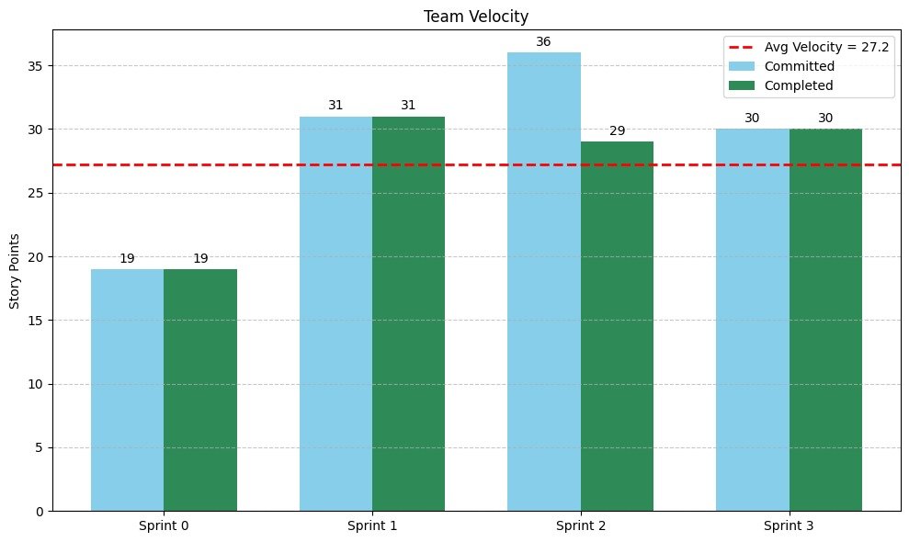
Sprint Velocity:

Slide 46
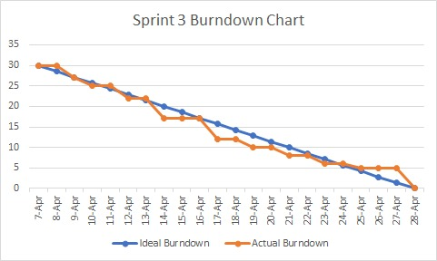
METRICS - BURNDOWN CHART

Slide 47
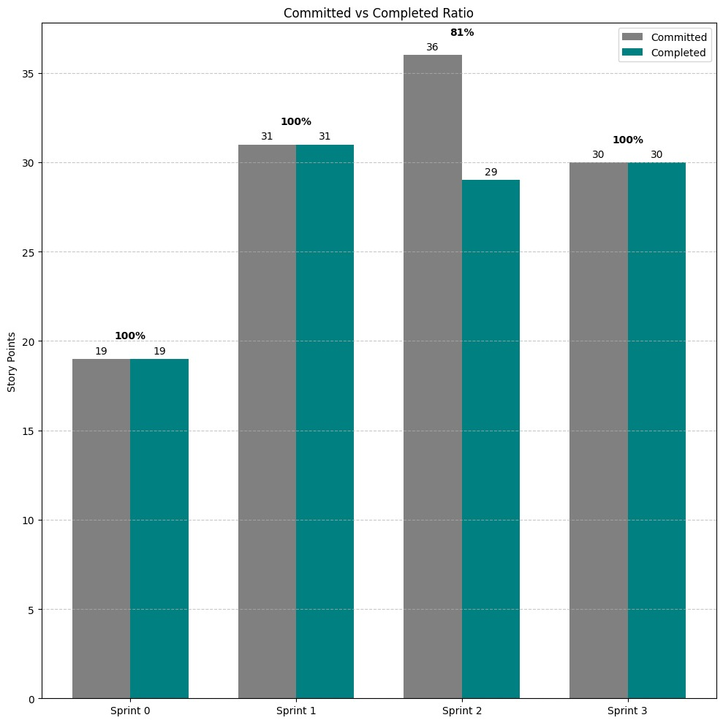
METRICS - COMMITTED RATIO

Slide 48
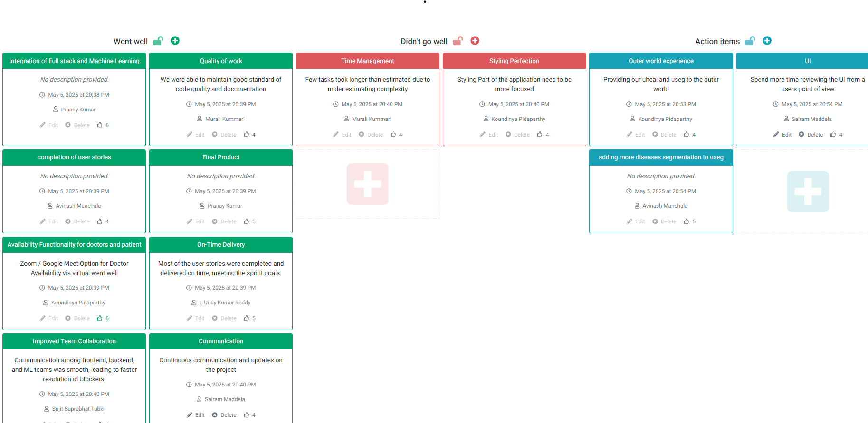
Sprint Retrospective:

Slide 49
Sprint Retrospective:
What Went Well | What Didn’t Go Well | Action Items
Integration of Full Stack and Machine Learning | Time management – some tasks took longer than expected | Spend more time reviewing the UI from a user's point of view
Quality of work – good code standards and documentation | Styling/perfection – UI styling needs improvement | Provide Useg and Uheal to the outside world
Completion of user stories |  | Add more disease segmentation to the Useg model
Final product stability
Availability functionality via Zoom/Google Meet worked
On-time delivery – met sprint goals

Slide 50
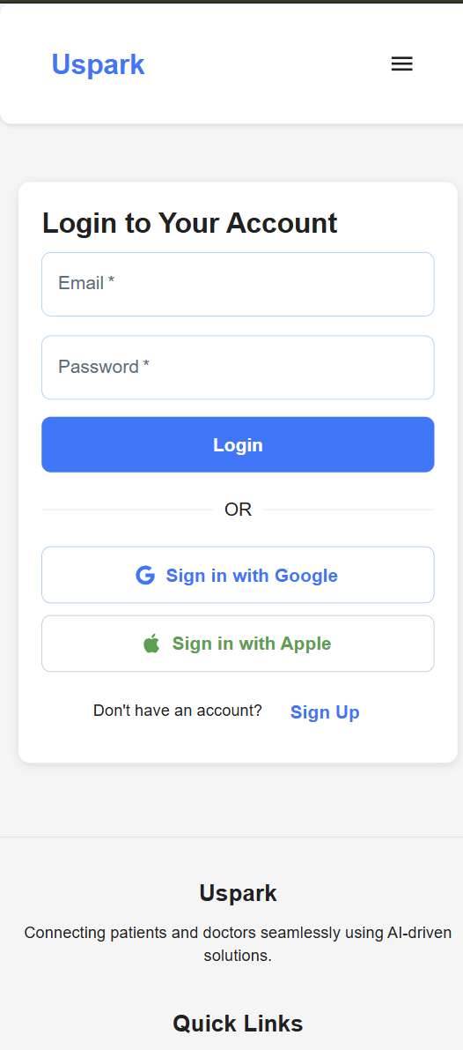
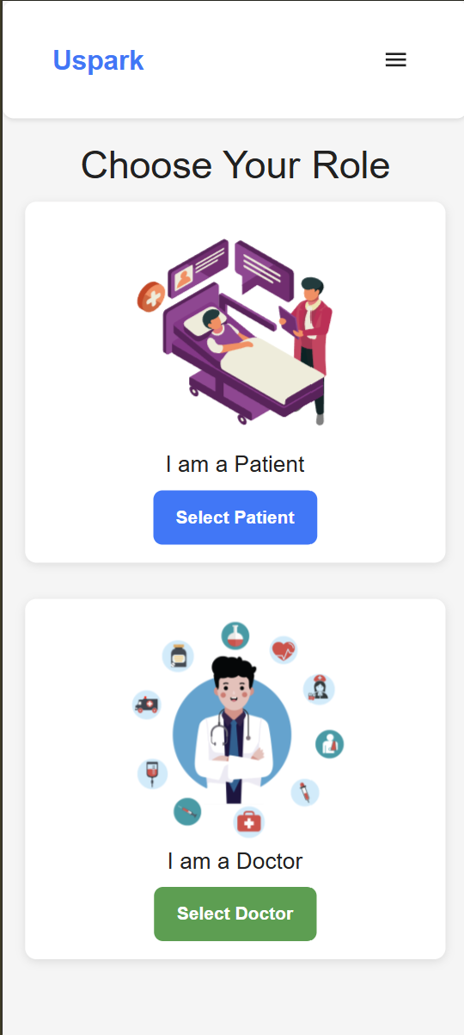
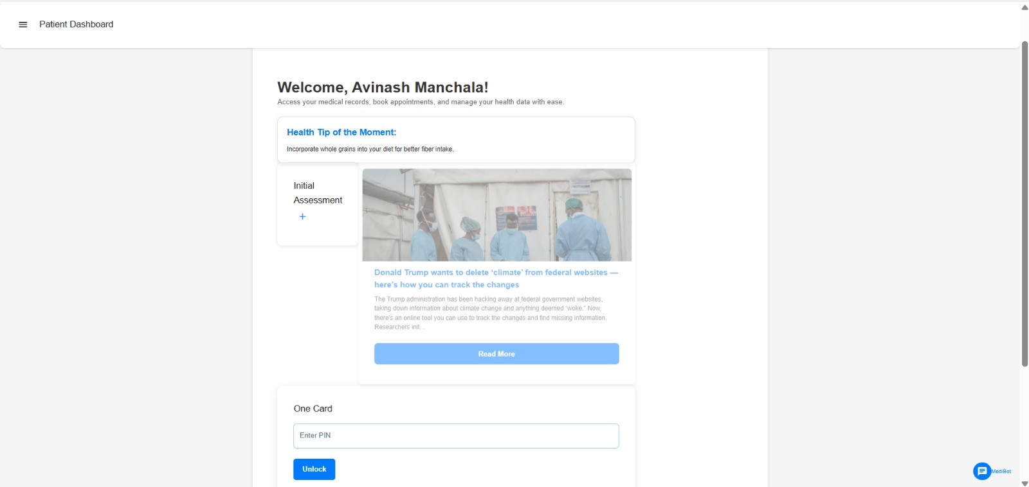
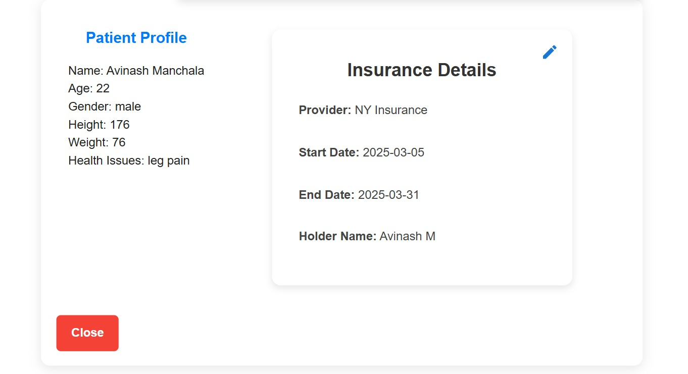
Project Demo

Slide 51
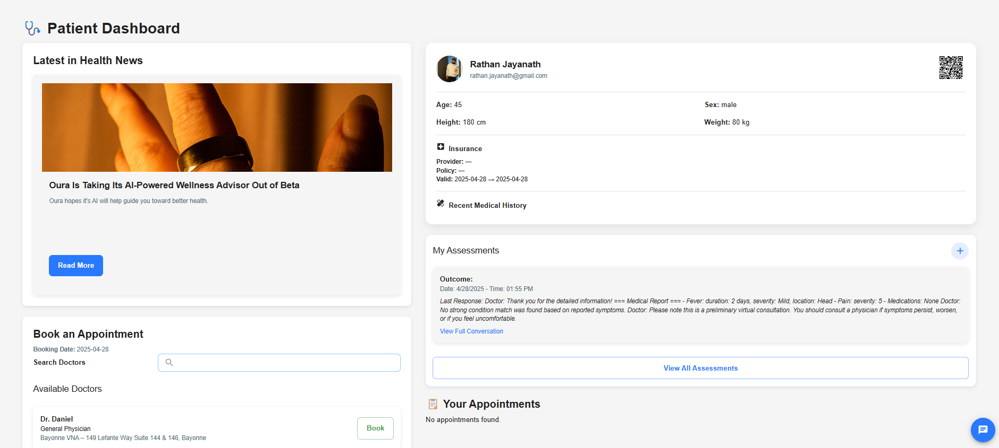
Application Screenshots

Slide 52
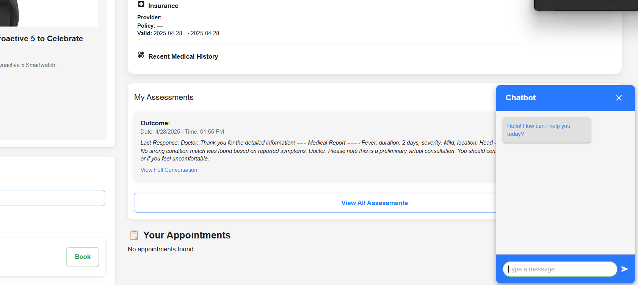
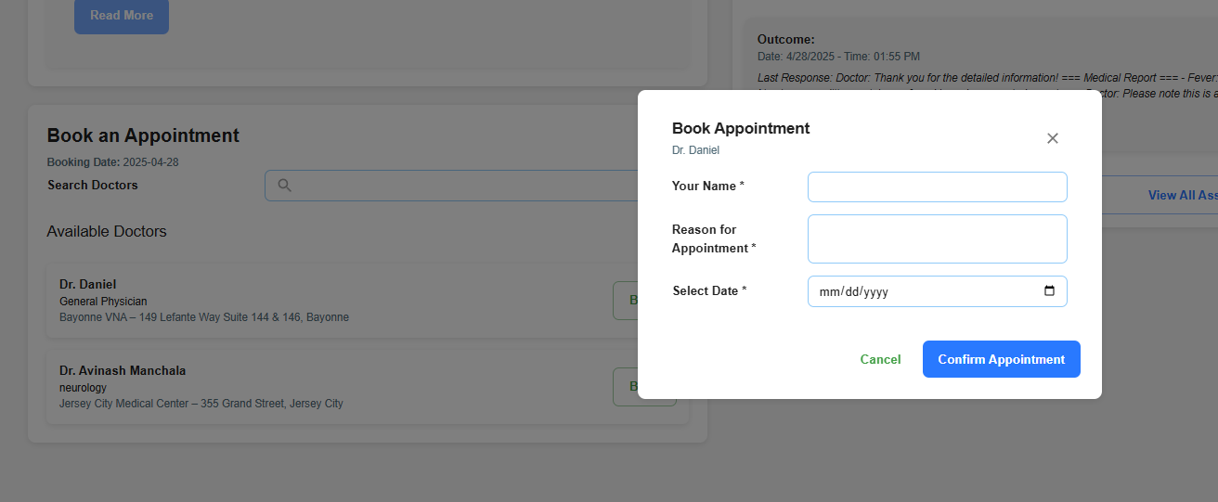
Application Screenshots

Slide 53
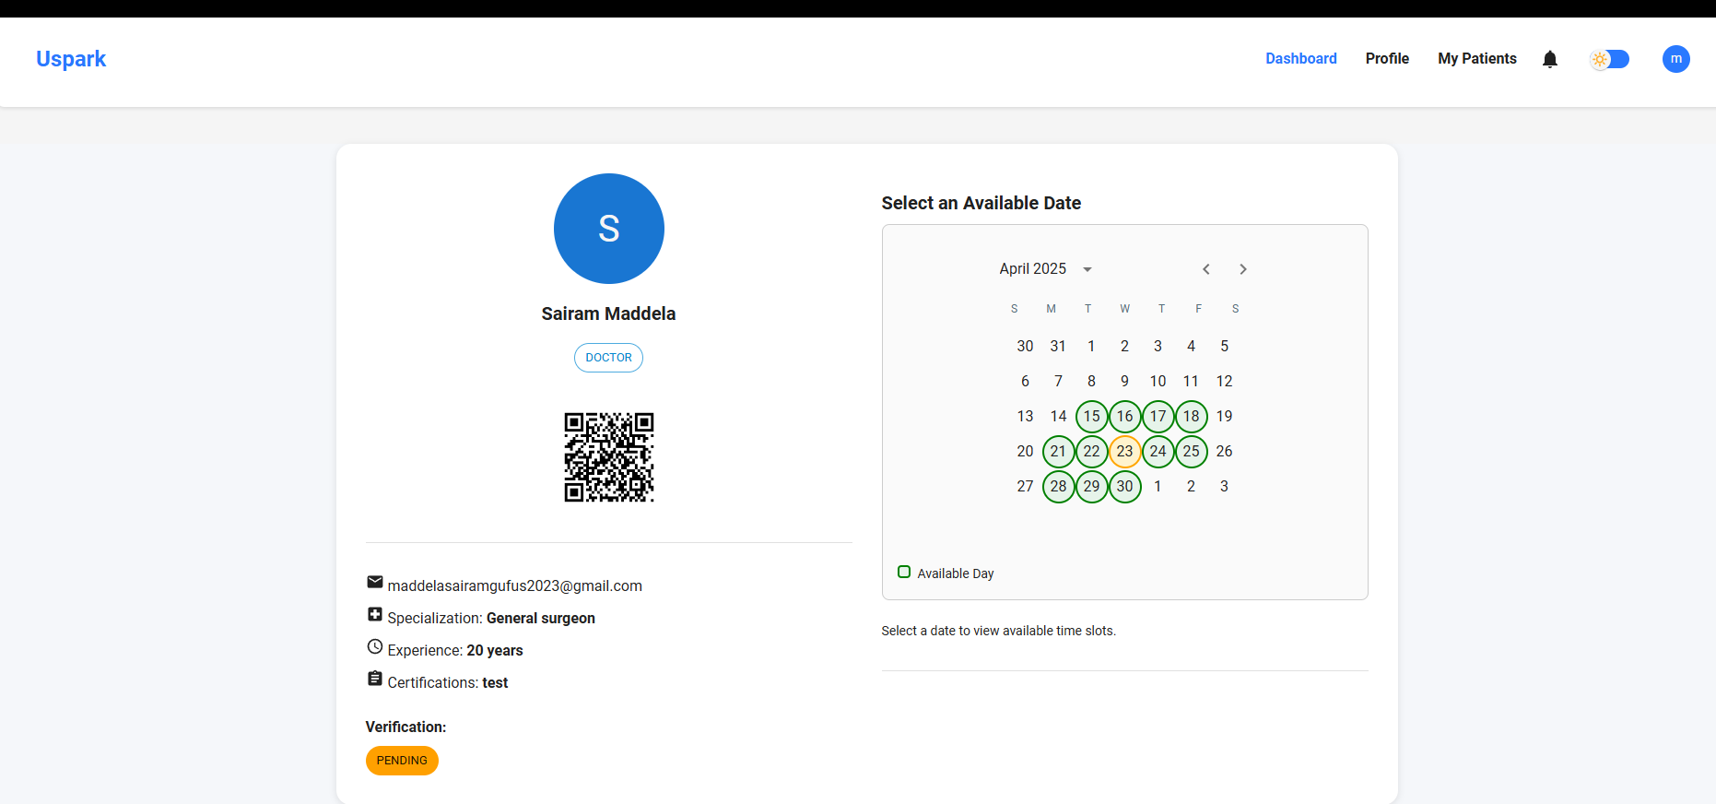
Application Screenshots

Slide 54
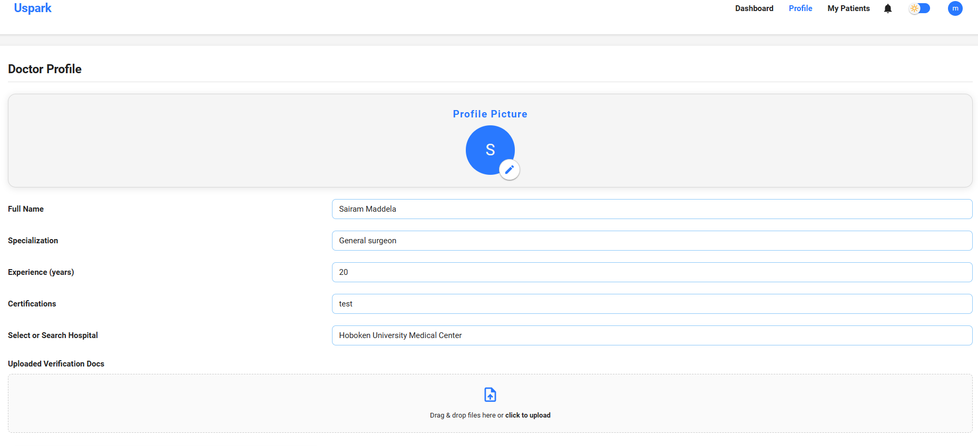
Application Screenshots

Slide 55
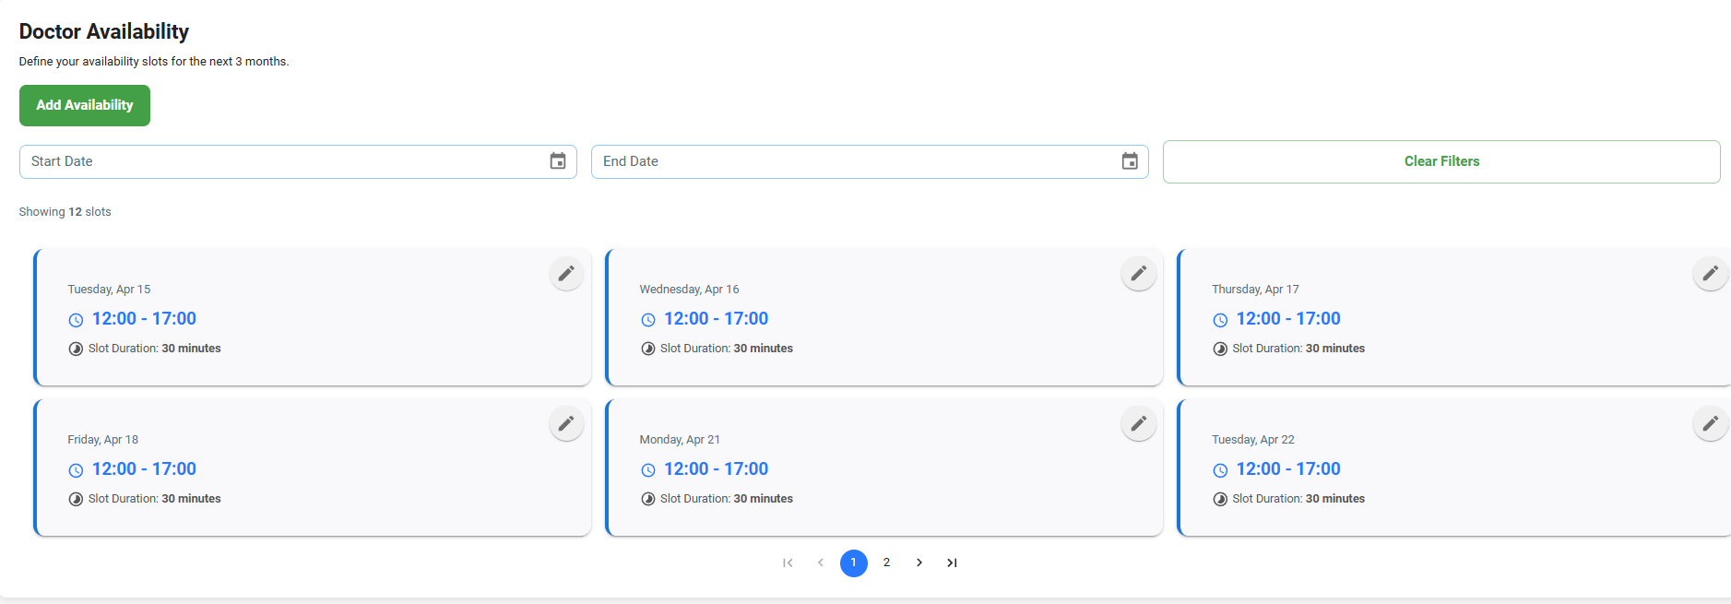
Application Screenshots

Slide 56
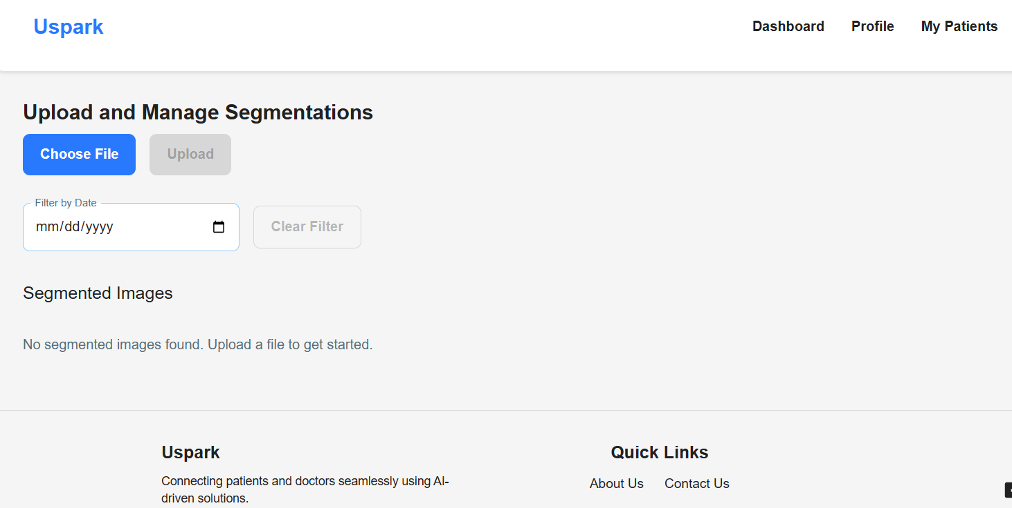
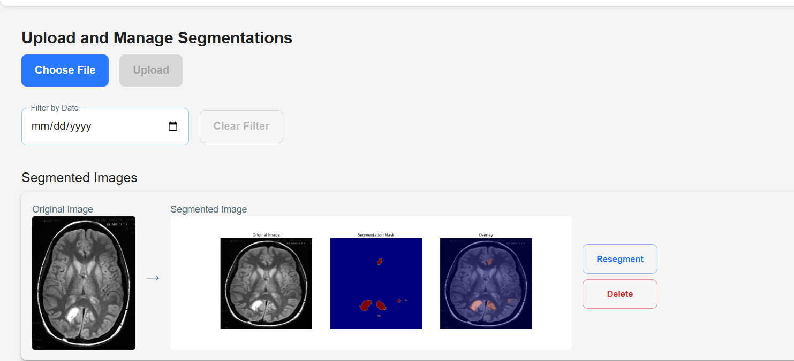
Application Screenshots

Slide 57
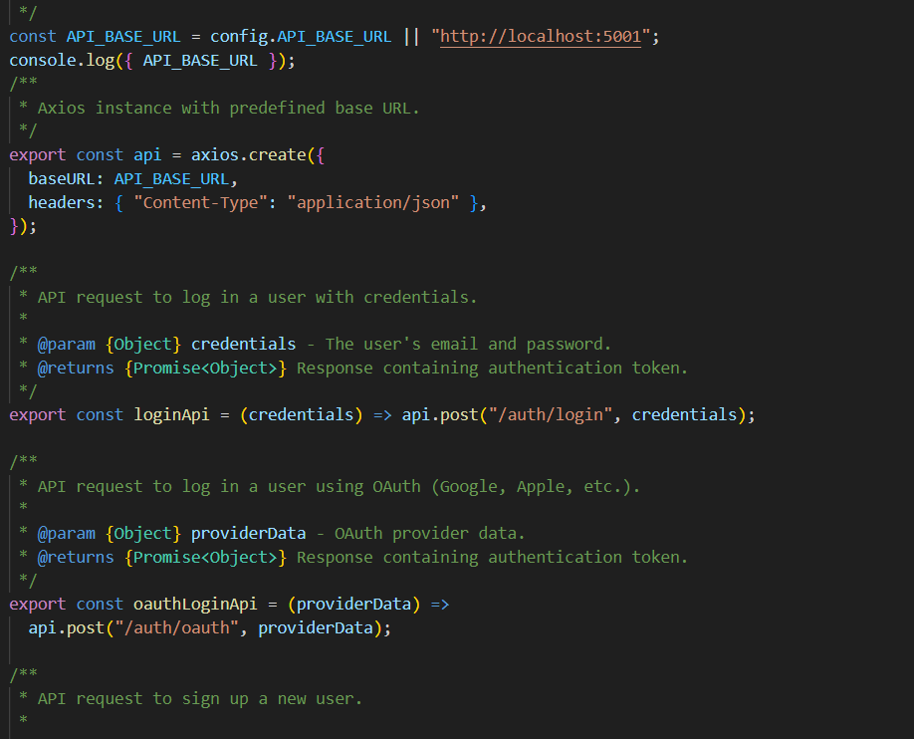
API Screenshots

Slide 58
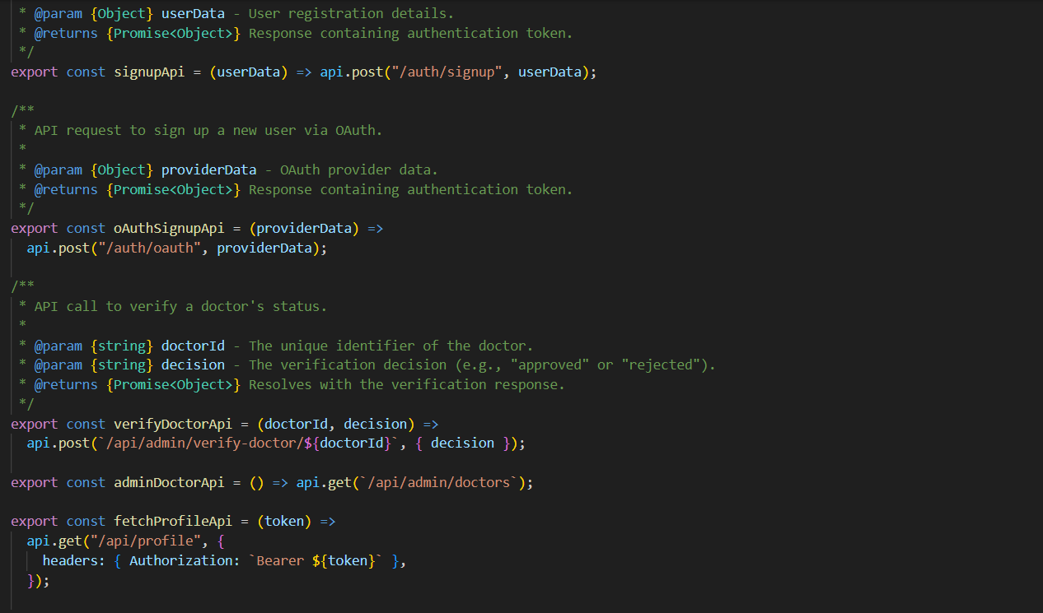
API Screenshots

Slide 59


API Screenshots

Slide 60
API Screenshots

Slide 61

WIKI PAGE
https://github.com/htmw/2025S-RushHour/wiki

Slide 62
THANK YOU
CONTACT US:
teamuspark@gmail.com

